Slide 1
A Beginner’s Guide to Building LLMs in Python
Presented by Thao-Trang Hoang
Portland Python User Group
Sponsored by New Relic
17:30 on Thursday, March 27th, 2025
Notes:
Good evening Portland Python User Group!

Slide 2



Gratitude and thanks
Notes:
I would like to first off take a moment to thank everyone here for attending.
I appreciate everyone for taking time out of their busy day to participate!
It is with gratitude that I share this presentation with you all <3.

Slide 3


Introduction
Thao-Trang (Greek letter Tau + Tron the movie)
Background

Slide 4

What are we doing?
We are building a large language model (LLM) in the Python coding language!
Notes:
Have demo ready for action after this slide!

Slide 5

Prerequisites
Python (latest version at this moment in time is 3.13) https://www.python.org/
OpenAI https://openai.com/
LangChain https://www.langchain.com/
LangChain_Community https://www.langchain.com/community
Streamlit https://streamlit.io/

Slide 6
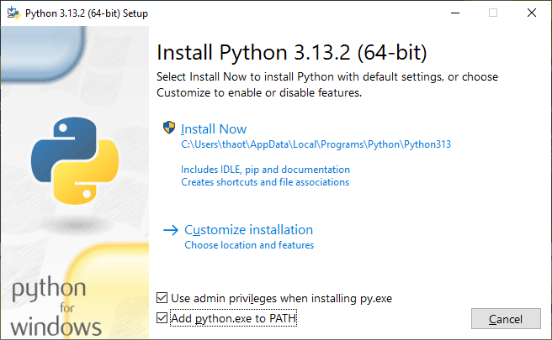
Install python & pip
Python (latest version is currently 3.13) https://www.python.org/
Be sure to click the checkboxes for:
“User admin privileges when installing py.exe”
“Add python.exe to PATH”

Slide 7

Terminal goodies to meet the prerequisites
pip install openai
pip install langchain
pip install langchain-community
pip install streamlit
Windows Users, if the above does not work, try:
py -m pip install [package]

Slide 8

Create a project directory/folder to store your LLM app in

Slide 9
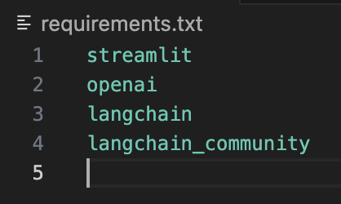
Dependencies file
First things first, let’s create that text file as a place to save the dependencies!
This can be done in any text editor of your choice, just save it as “requirements.txt”

Slide 10
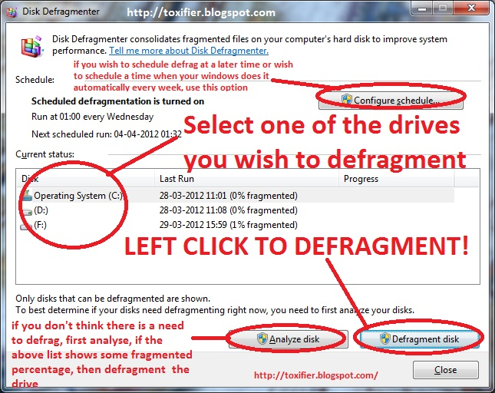

Code Defragmentation
What does this mean?
I understand what it means!

Slide 11
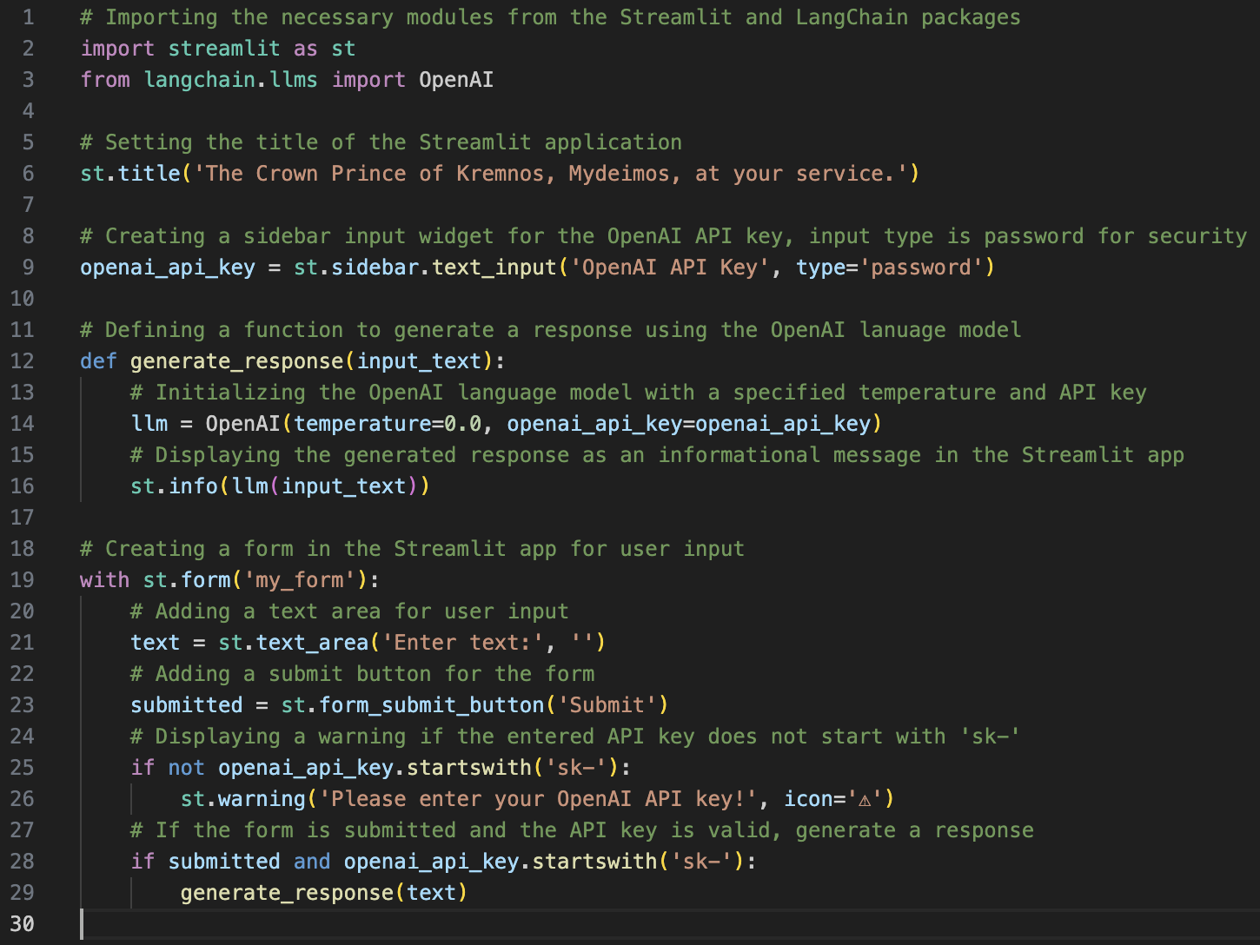
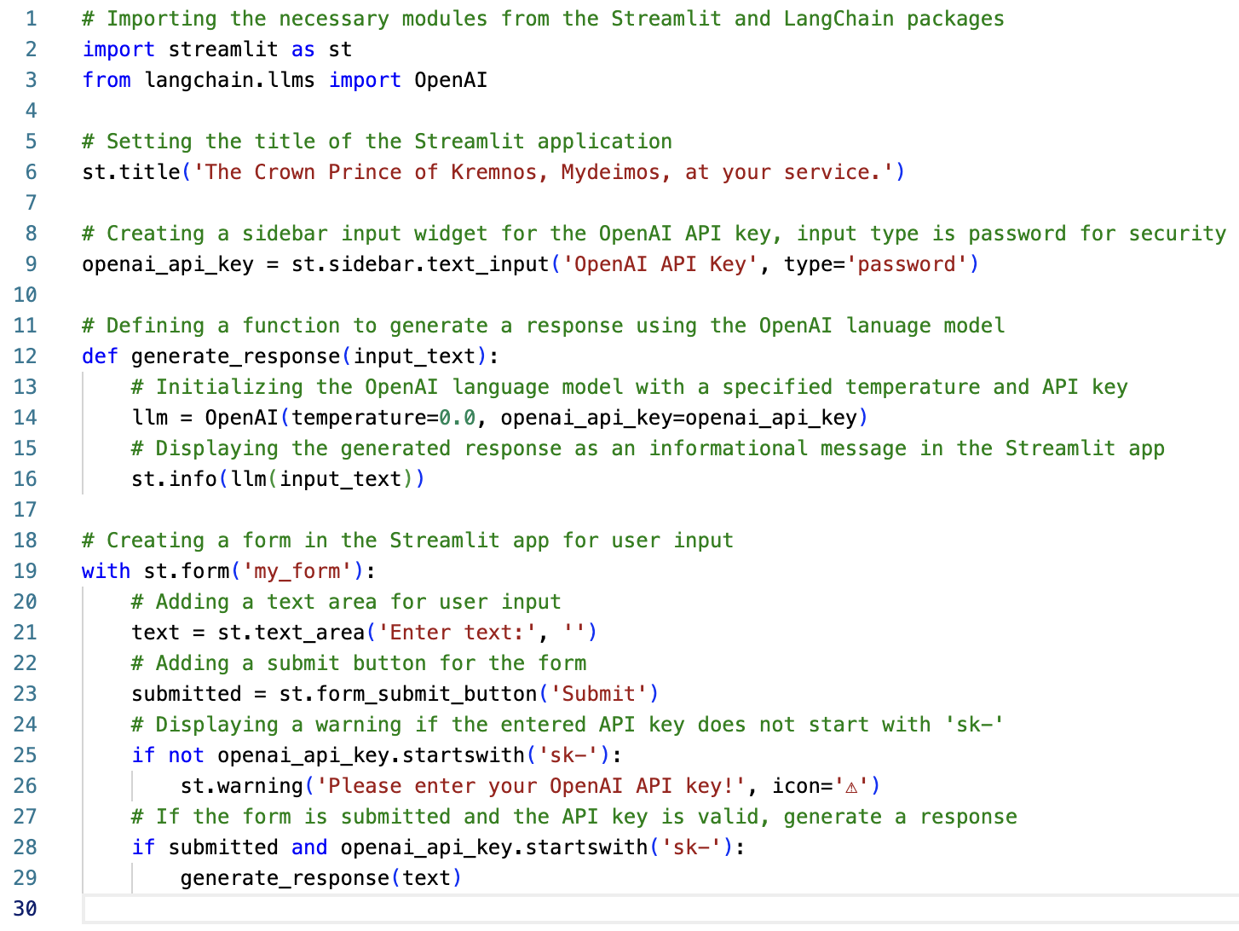
The code, the myth, the legend

Slide 12
Import libraries
Streamlit – Streamlit helps turn your data scripts into shareable web apps in minutes. All in pure Python. No front‑end experience required.
Langchain – Langchain is a framework designed to simplify the development of applications that leverage LLMs. It provides tools and utilities to manage and streamline the various aspects of working with LLMs, making building complex and robust applications easier.
OpenAI – OpenAI is a research organization and technology company that aims to ensure artificial general intelligence (AGI) benefits all of humanity.
Notes:
- Imports the Streamlit library, which is used to create interactive web applications.
- from langchain.llms import OpenAI imports the OpenAI class from the langchain.llms module, which is used to interact with OpenAI's language models.
Streamlit – Streamlit helps turn your data scripts into shareable web apps in minutes. All in pure Python. No front‑end experience required.
Langchain – Langchain is a framework designed to simplify the development of applications that leverage LLMs. It provides tools and utilities to manage and streamline the various aspects of working with LLMs, making building complex and robust applications easier.
OpenAI – OpenAI is a research organization and technology company that aims to ensure artificial general intelligence (AGI) benefits all of humanity.

Slide 13
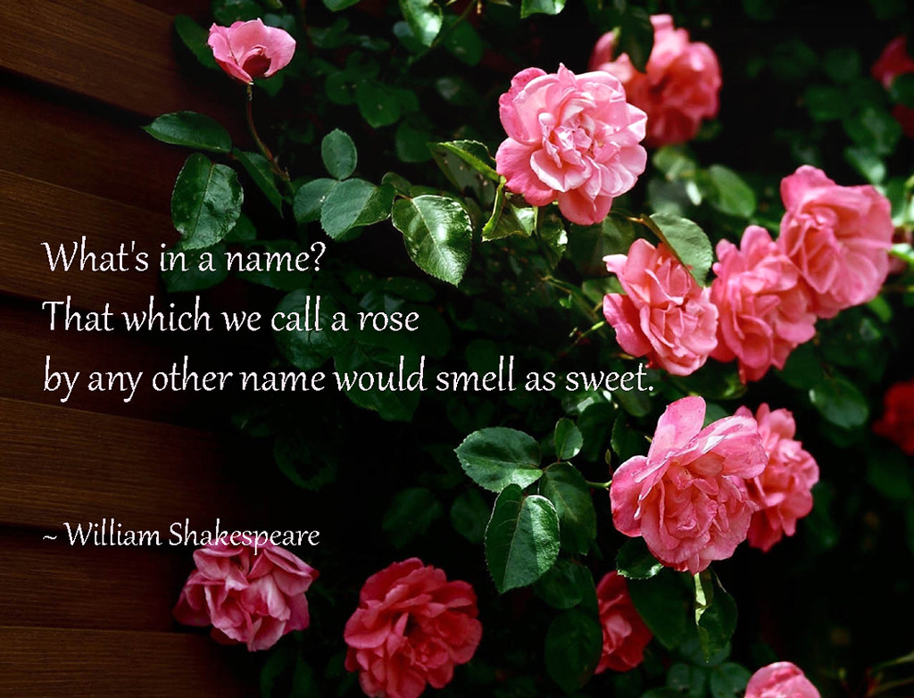
Setting the title

Slide 14

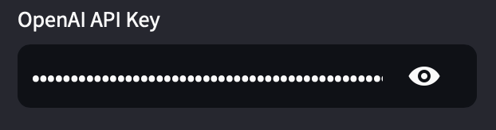
Create the sidebar Widget for OpenAI API KEY
This is like the key to spend API tokens and run the LLM app, i.e. think putting quarters into an arcade or pinball machine!
Notes:
openai_api_key = st.sidebar.text_input('OpenAI API Key', type='password') creates a text input widget in the sidebar for the user to input their OpenAI API key.
The input type is set to 'password' to hide the entered text for security.

Slide 15
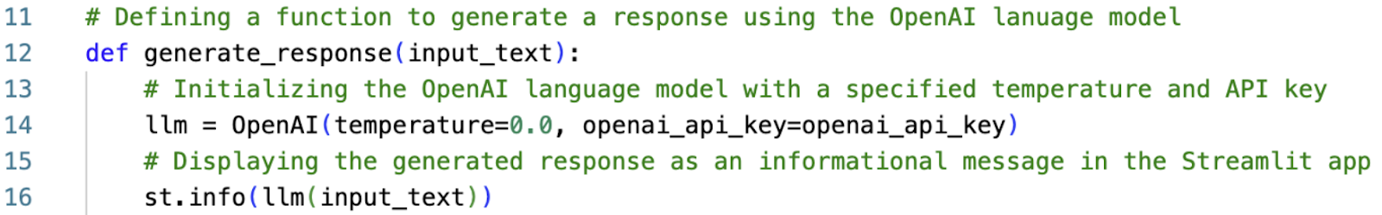
Defining a function to generate a response
Temperature is a parameter used to control the randomness or creativity of the text generated by a language model. It determines how much variability the model introduces into its predictions.
Low Temperature (0.0 - 0.5): This makes the model more deterministic and focused.
Medium Temperature (0.5 - 1.0): Provides a balance between randomness and determinism.
High Temperature (1.0 and above): Increases the randomness of the output. Higher values make the model more creative and diverse in its responses, but this can also lead to less coherence and more nonsensical or off-topic outputs.
Notes:
def generate_response(input_text) defines a function named generate_response that takes input_text as an argument.
llm = OpenAI(temperature=0.7, openai_api_key=openai_api_key) initializes the OpenAI class with a temperature setting of 0.7 and the provided API key.
Temperature is a parameter used to control the randomness or creativity of the text generated by a language model. It determines how much variability the model introduces into its predictions.
Low Temperature (0.0 - 0.5): This makes the model more deterministic and focused.
Medium Temperature (0.5 - 1.0): Provides a balance between randomness and determinism.
High Temperature (1.0 and above): Increases the randomness of the output. Higher values make the model more creative and diverse in its responses, but this can also lead to less coherence and more nonsensical or off-topic outputs.
st.info(llm(input_text)) calls the language model with the provided input_text and displays the generated response as an informational message in the Streamlit app.

Slide 16
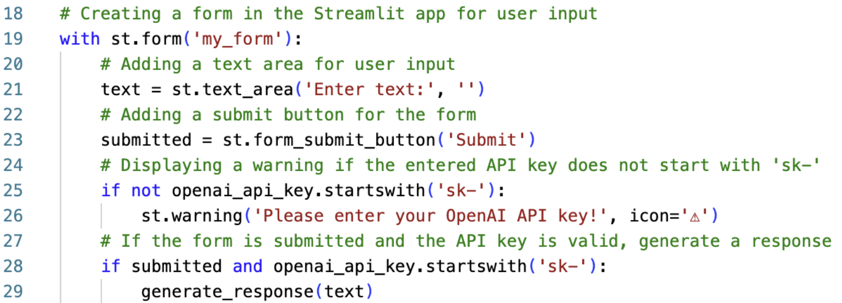
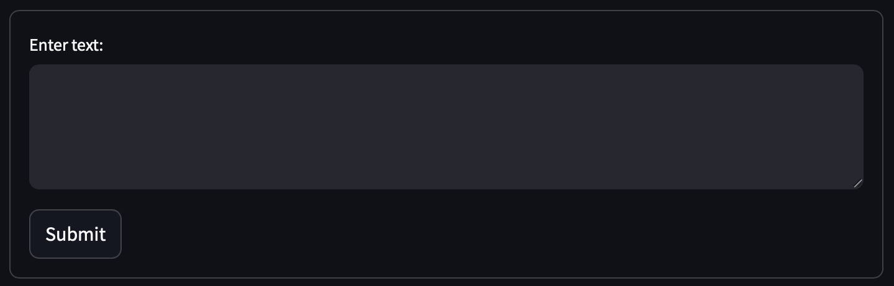
Creating the form for input and output
Notes:
- with st.form('my_form') creates a form container named my_form.
- text = st.text_area('Enter text:', '') adds a text area input widget within the form for the user to enter text.
- submitted = st.form_submit_button('Submit') adds a submit button to the form.
- if not openai_api_key.startswith('sk-') checks if the entered API key does not start with sk-.
- st.warning('Please enter your OpenAI API key!', icon='⚠') displays a warning message if the API key is invalid.
- if submitted and openai_api_key.startswith('sk-') checks if the form is submitted and the API key is valid.
- generate_response(text) calls the generate_response function with the entered text to generate and display the response.

Slide 17
The code, the myth, the legend
Notes:
We now have the entire code completed!

Slide 18

Let’s lean with it, rock with it, Lean with it, rock with it… Let’s run the application!
streamlit run [nameOfApp].py
Notes:
- The application is ready; we need to execute the application script using the appropriate command for the framework we're using.

Slide 19
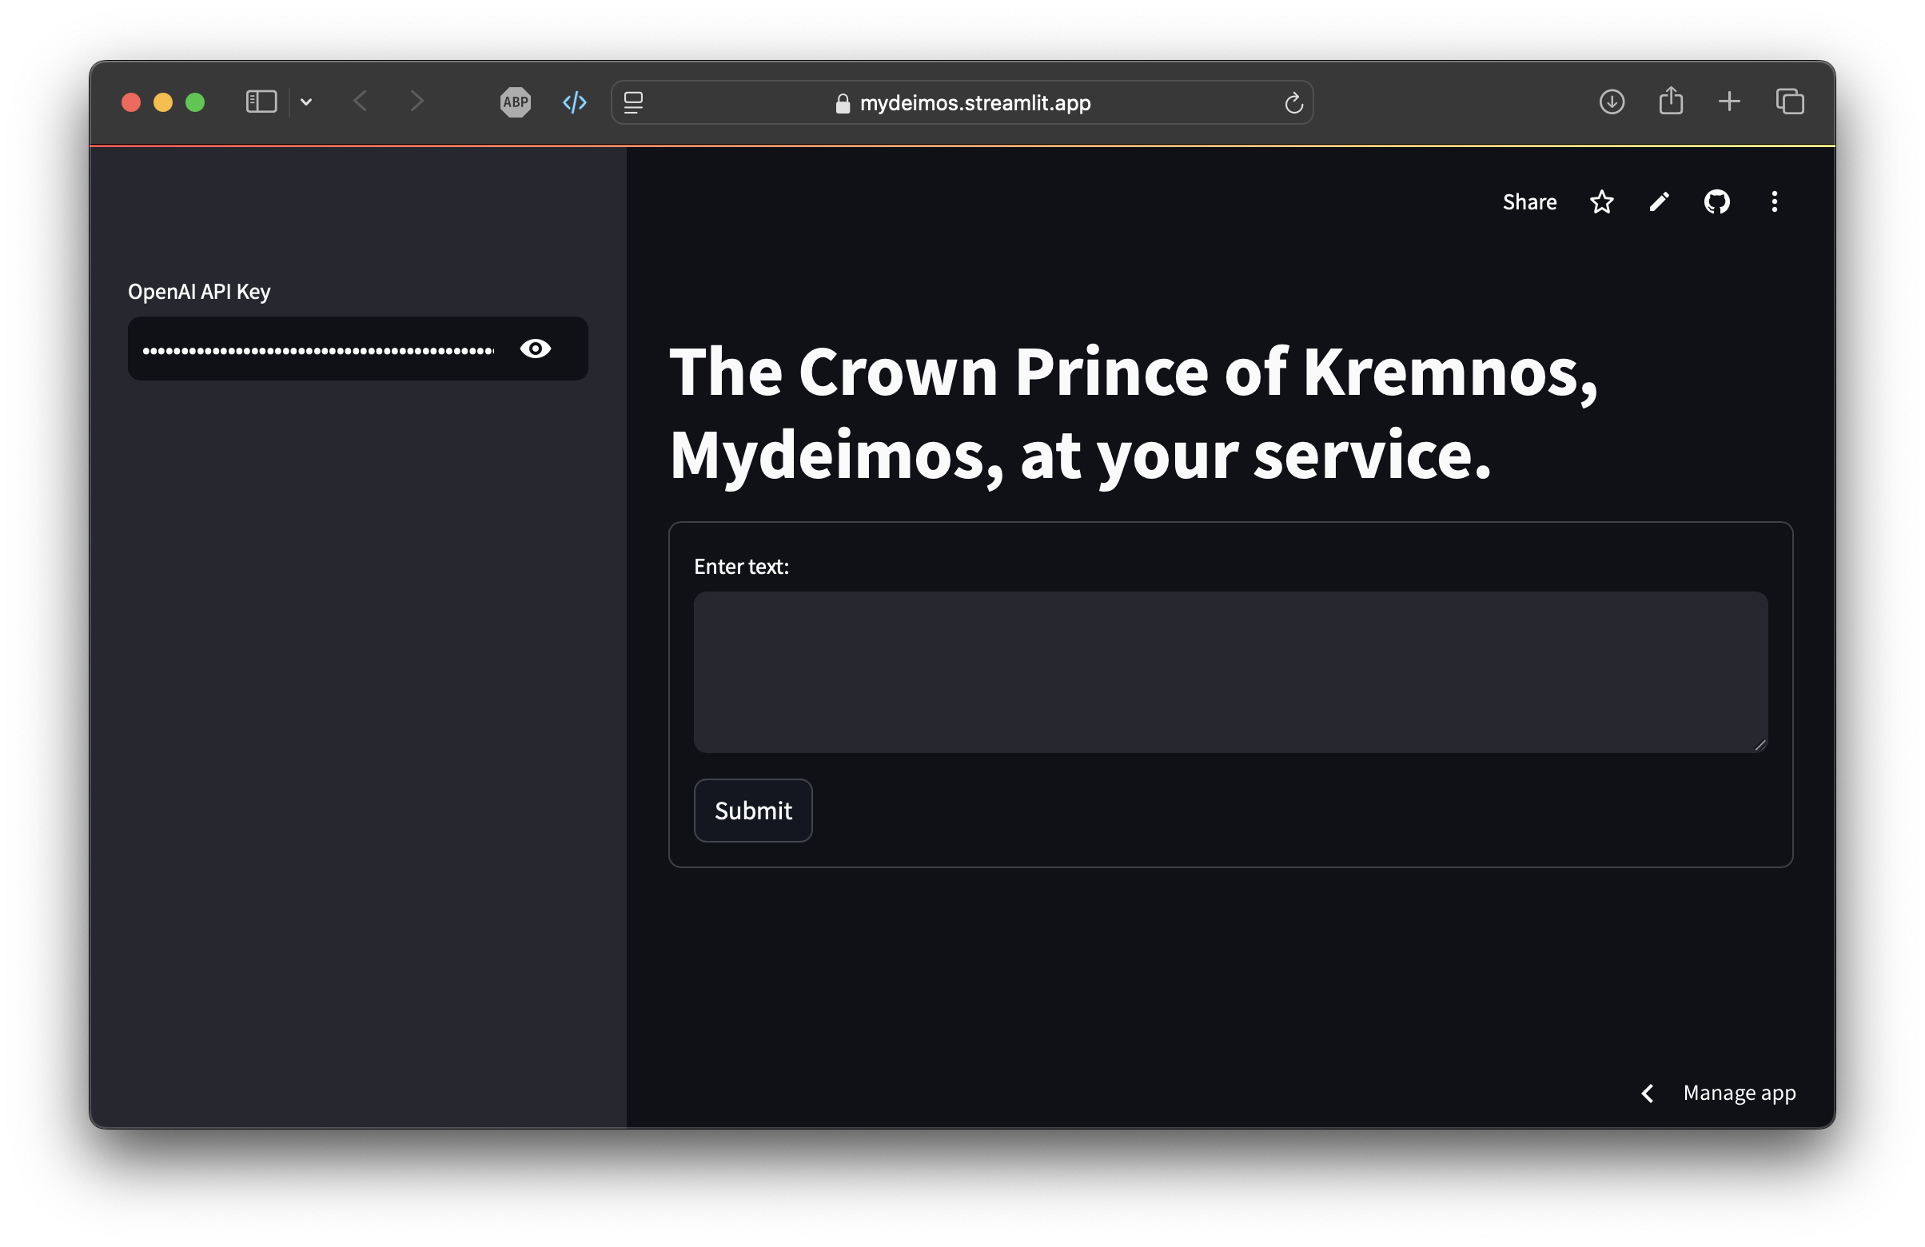
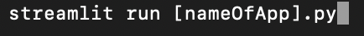
When you execute
to run the application, the following happens:
The Streamlit server starts
Code Execution
Web Interface
Notes:
- By running this code using streamlit run [nameOfApp].py, you create an interactive web application where users can enter prompts and receive LLM-generated text responses.
- When you execute streamlit run [nameOfApp].py, the following happens:
1. Streamlit server starts: Streamlit starts a local web server on your machine, typically accessible at `http://localhost:8501` by default.
2. Code execution: Streamlit reads and executes the code in `app.py,` rendering the app as defined in the script.
3. Web interface: Your web browser automatically opens (or you can manually navigate) to the URL provided by Streamlit (usually http://localhost:8501), where you can interact with your LLM app.

Slide 20

Thank you
Connect with me, Thao-Trang: https://linkedin.com/in/thaotranghoang

